Slide 1
Green Beard Effect
Kellie Hanser
BI300 – Honors Project

Slide 2
Genes favored by natural selection
1. Direct Fitness Benefit
2. Indirect Fitness Benefit
Important

Slide 3
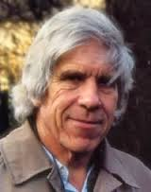
Altruism
William Hamilton
“The Genetic Evolution of Social Behavior”
1964

Slide 4
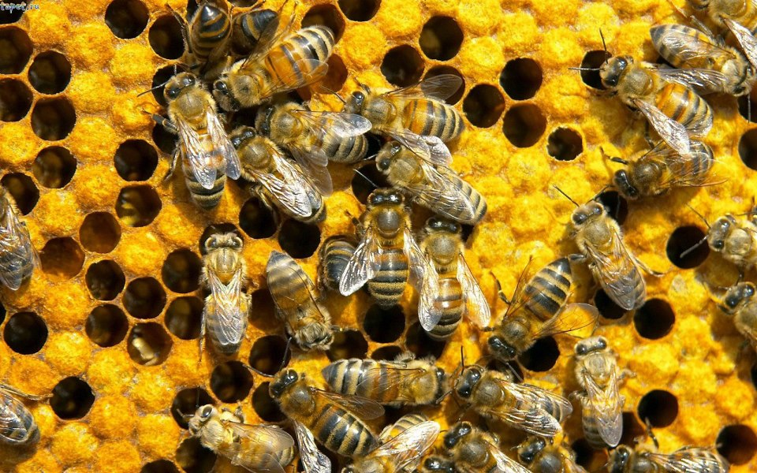
So what is altruism?
behavior that benefits others at a personal cost to the behaving individual
← Most common example

Slide 5
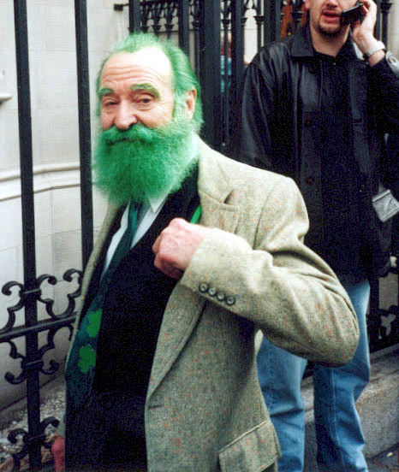
Two forms of altruism
Kin Recognition
Greenbeard
Ability to identify between close genetic kin and non-kin

Slide 6
greenbeard effect?
Richard Dawkins 1976
[Gene produces a phenotypic effect that is perceivable by others with this same trait which causes special treatment to those recognized]
However, a visible tag is NOT always required!

Slide 7
Key Difference Between kin recognition and green beard effect

Slide 8

Why is this effect important?

Slide 9
As it turns out… there is 4 types of green beards
Facultative-helping
Obligate-helping
Facultative-harming
Obligate-harming

Slide 10
Facultative-helping
Greenbeard actor facultatively adjusting his social behavior so as to provide help only to those who carry the greenbeard gene
Slime mold: Dictyostelium discoideum

Slide 11
Obligate-helping
Greenbeard expresses the helping behavior in all social interactions, but only carries of the greenbeard gene can benefit from this help
Agrobacterium tumefaciens

Slide 12
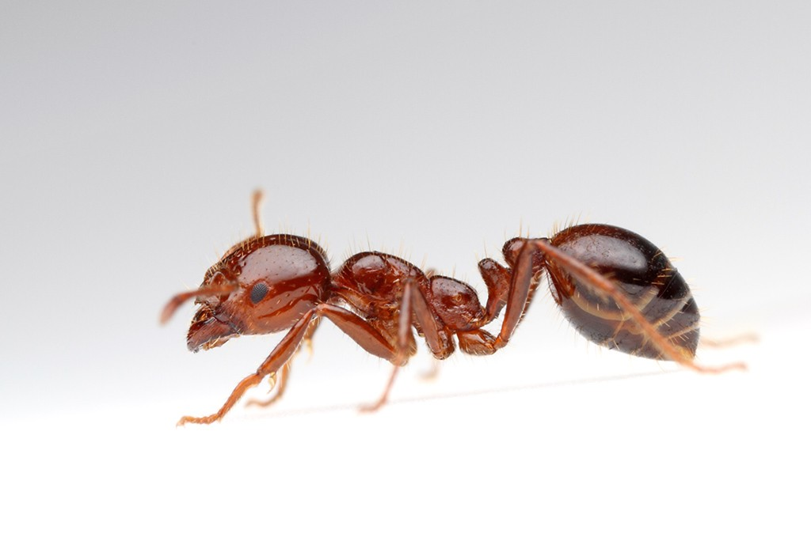
Facultative-Harming
•Greenbeard actor facultatively adjusting his social behavior so as to inflict harm only against those social partners who do not carry the greenbeard gene
Gp-9 gene of the red fire ant

Slide 13
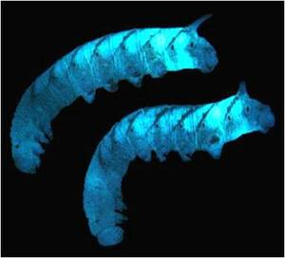
Obligate-harming
Greenbeard actor expressing the harming behavior in all social interactions, but carriers of the greenbeard gene is immune to the behaviors harmful effects
Bacteriocin-encoding genes
of the bacterium
Photohabdus Iuminescens

Slide 14
Why greenbeards are easily looked over
Conceived as a thought experiment to illustrate a technical point about genetic relatedness and were thought unlikely to occur in the real world
Greenbeards would often be hard to find, because frequency-dependent selection would usually drive them to fixation making their effects difficult to detect
Greenbeards come from microorganisms
The relatively simpler link between genotype and phenotype may prevent a decoupling of beard and behavior

Slide 15
Greenbeard dynamics
The greenbeard is selected against at low frequencies and only favored when it has established itself to a certain frequency
A potential complication with detecting greenbeards in nature is that, if they can invade, the selection will drive them to fixation which can obscure the greenbeard mechanism
For obligate harming greenbeards, the harming action will continue to be expressed even in the absence of nongreenbeard victims
For facultative harming greenbeards, once the gene has been driven to fixation there are no nongreenbeard individuals to elicit the harming behavior or to be harmed by this, is that phenotypic effects of the greenbeard gene disappear entirely

Slide 16
Greenbeard’s
Misconception
Reality
There is one type of greenbeard
Greenbeard effect is a type pf genetic kin recognition
Greenbeard effect provides a robust explanation for the cooperation in organisms
There are 4 types of greenbeards
Greenbeard effect is distinct from kin recognition
Greenbeard effect is vulnerable to “false beards” and hard to indentify

Slide 17
Questions?

